Slide 1
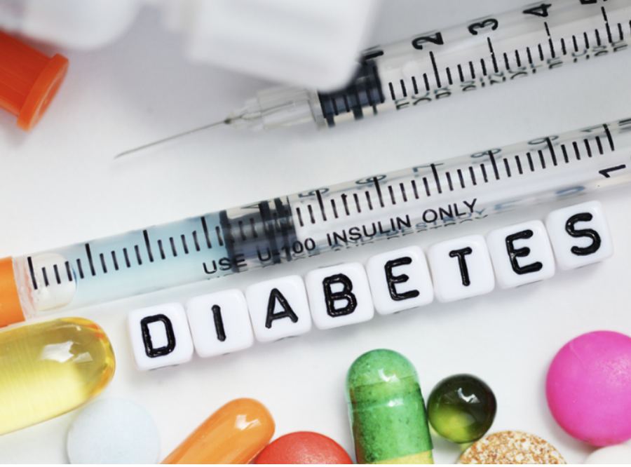
Predicting Diabetes with Machine Learning
(Group 10)

Slide 2




WHO WE ARE ?
The Sweet
DATA Detectives
ZAID AL DULAIMI - TORONTO
LINTU BABY – WOODSTOCK
ANABEL SCARANELO – TORONTO

Slide 3

Disclosures
We do not have any financial interests.

Slide 4

Learning Objectives
After this presentation you will know…
A brief overview about Diabetes Mellitus (DM),
a very bad disease.
How we could train different
Machine learning models
to achieve the best accuracy to determine if someone could be at risk.

Slide 5

Our goals
Identify
Databases that are accurate and pre-process the data.
Classify
and Identify DM patients by using machine learning algorithms.
Build
A model using supervised machine learning algorithms that predict DM.

Slide 6
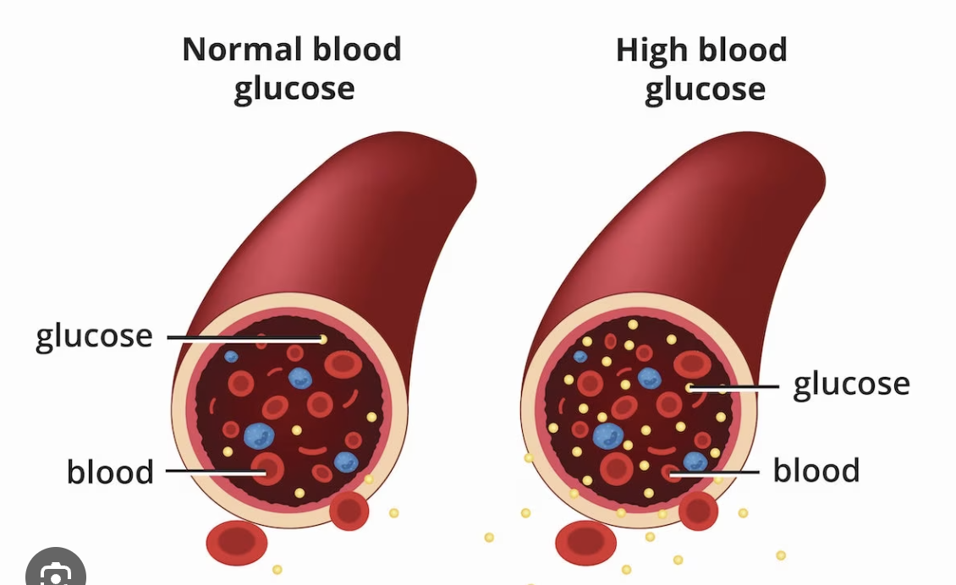
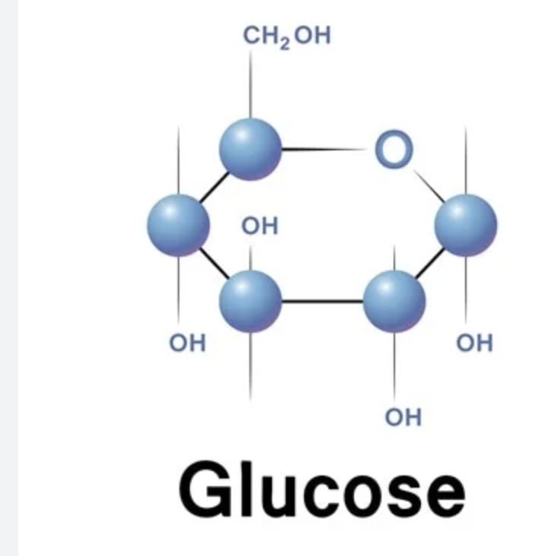


Brief Overview: Diabetes Mellitus

Slide 7
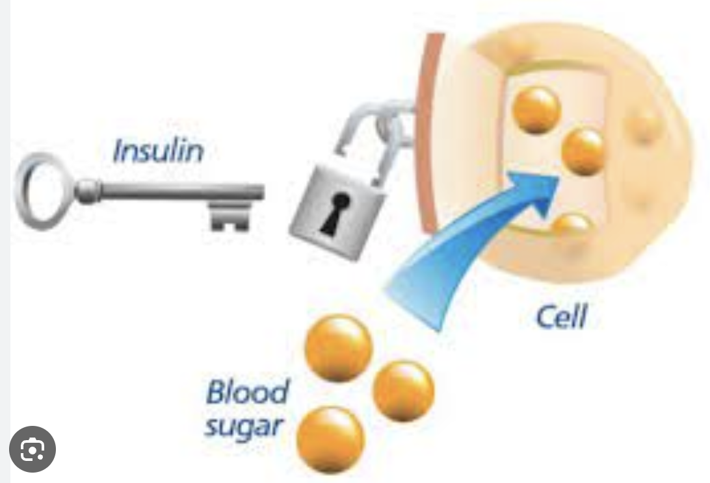
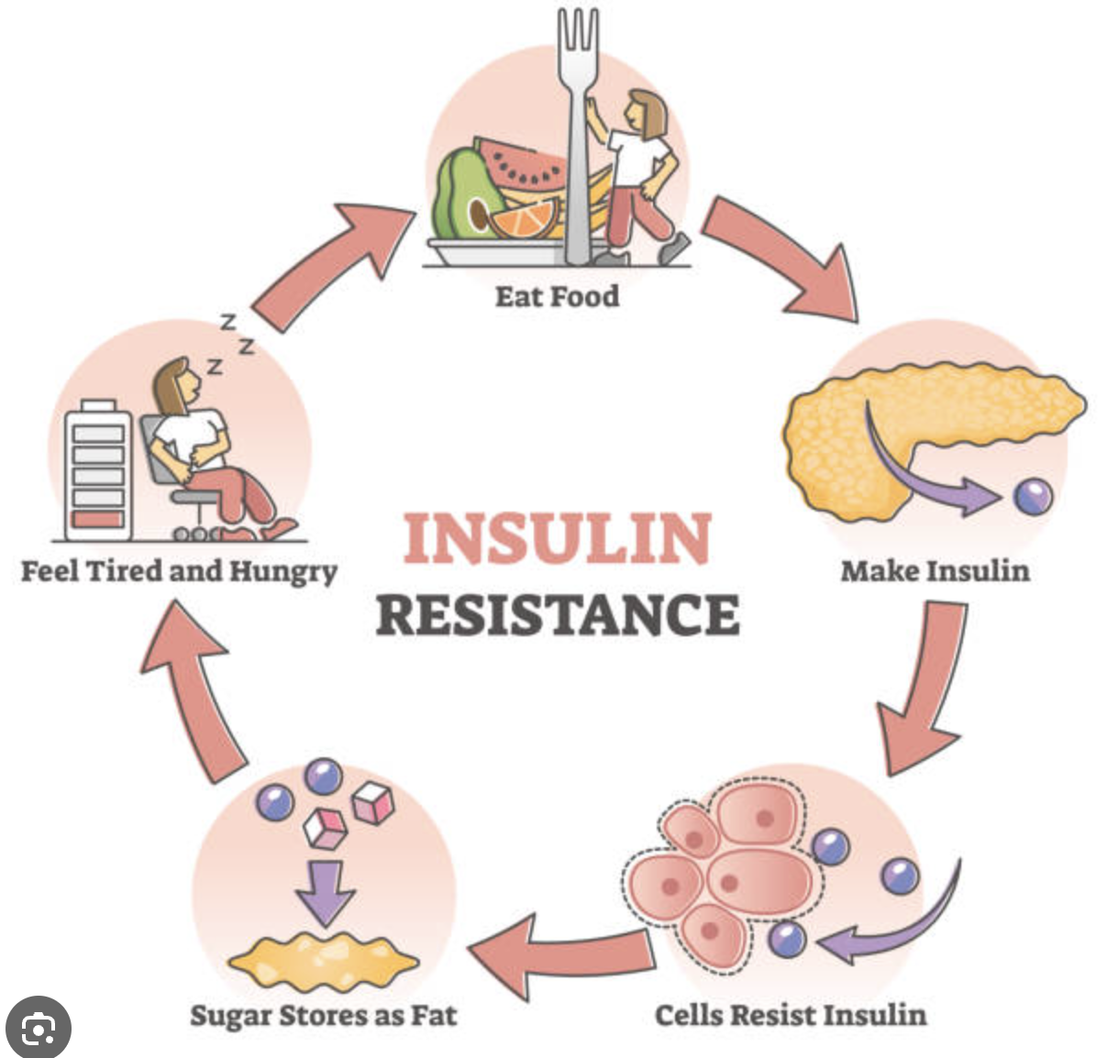
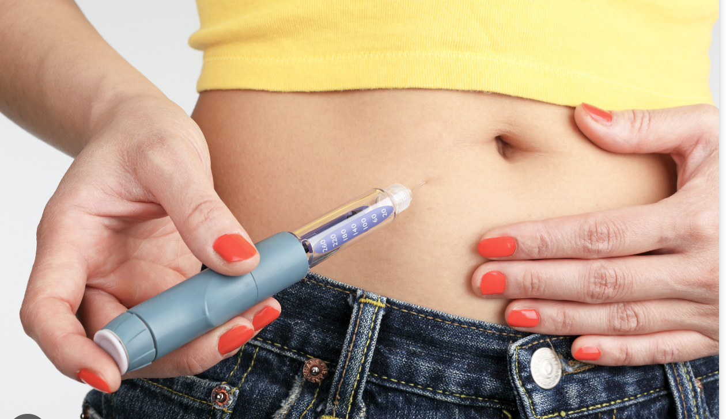
Insulin is ineffective
Type 2
Not enough insulin – type 1
Notes:
There are two types of diabetes: type 1 (not enough insulin) and type 2 (ineffective insulin). People with type 1 need insulin injections or pumps, while those with type 2 may need to eat healthy, exercise, and sometimes take medicine.
People with diabetes need to be careful about their blood sugar levels by checking them regularly with a glucose meter. They should eat healthy, exercise, and take prescribed medicines to keep their blood sugar in the right range.

Slide 8
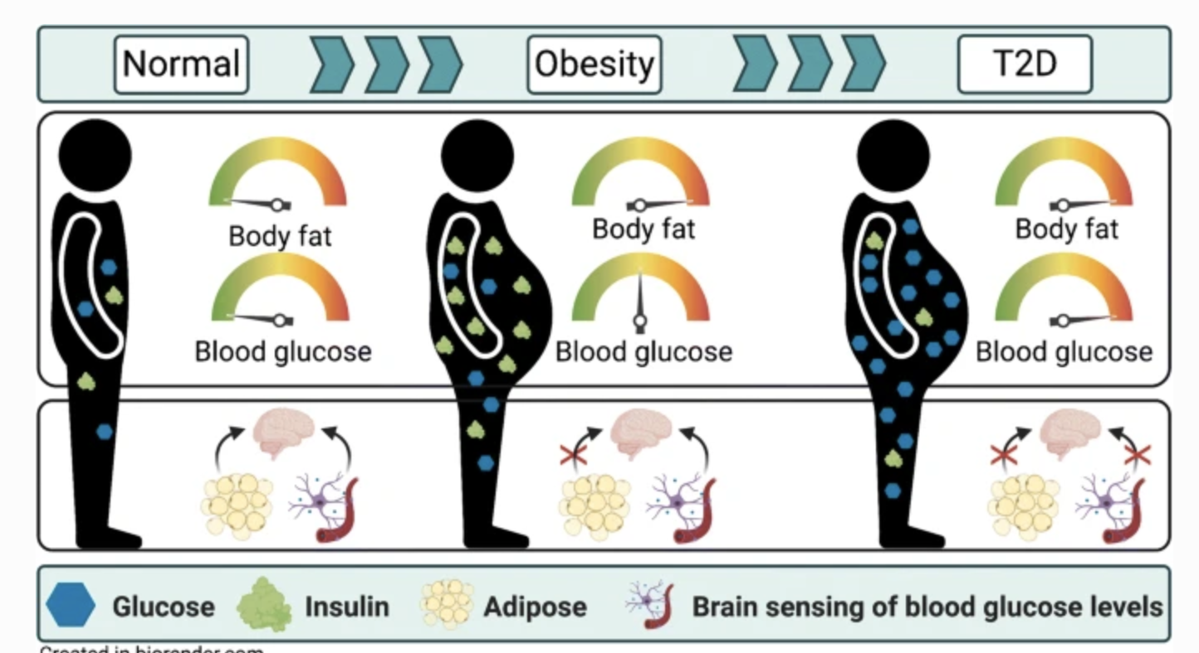

Slide 9
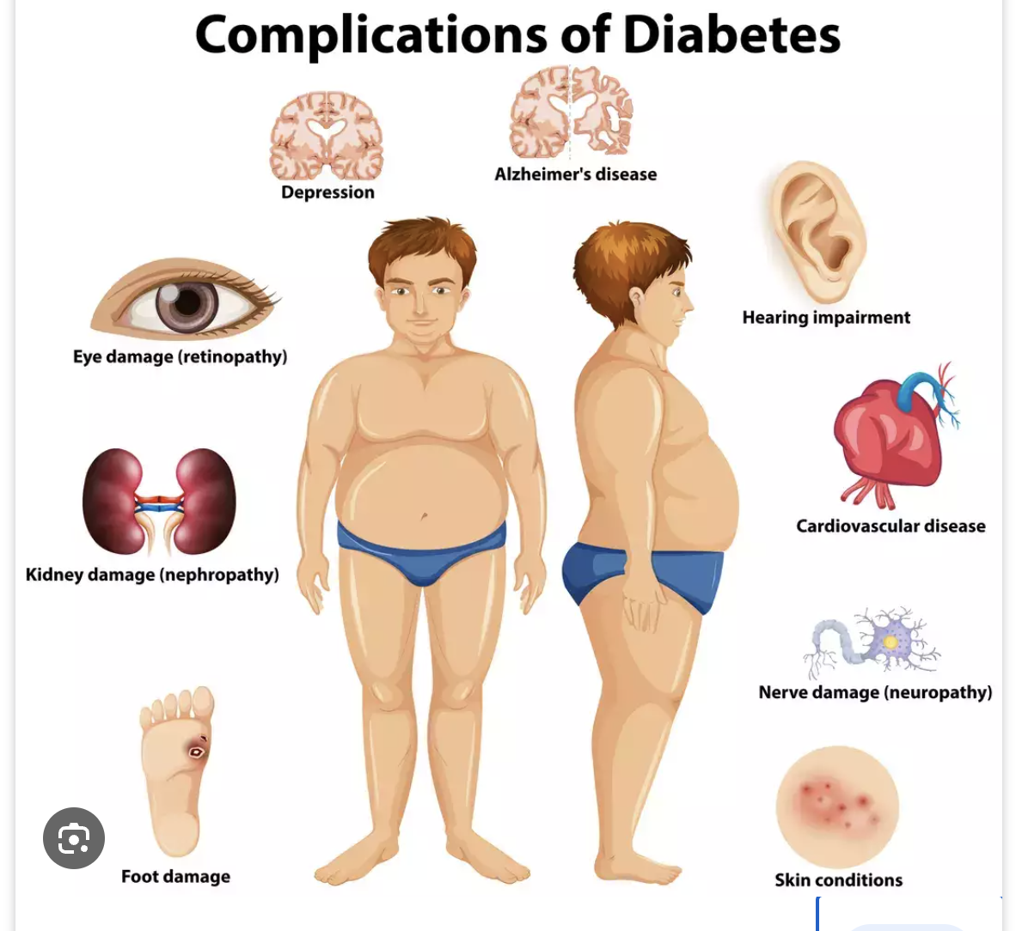
You don’t want to get this nasty disease!
Please Eat well,
Be physically active,
Maintain a healthy weight,
Live tobacco-free
Manage Stress.

Slide 10

Machine Learning Workflow Five Stages: 1. Gathering Data 2. Pre-Processing Data 3. Researching the model that would fit best for the type of data 4. Training and testing the model 5. Evaluating

Slide 11
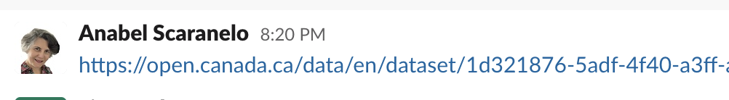
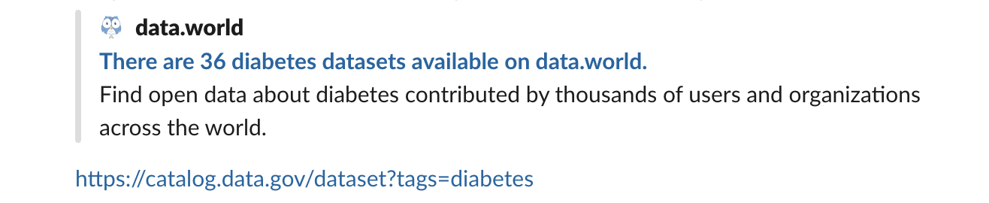
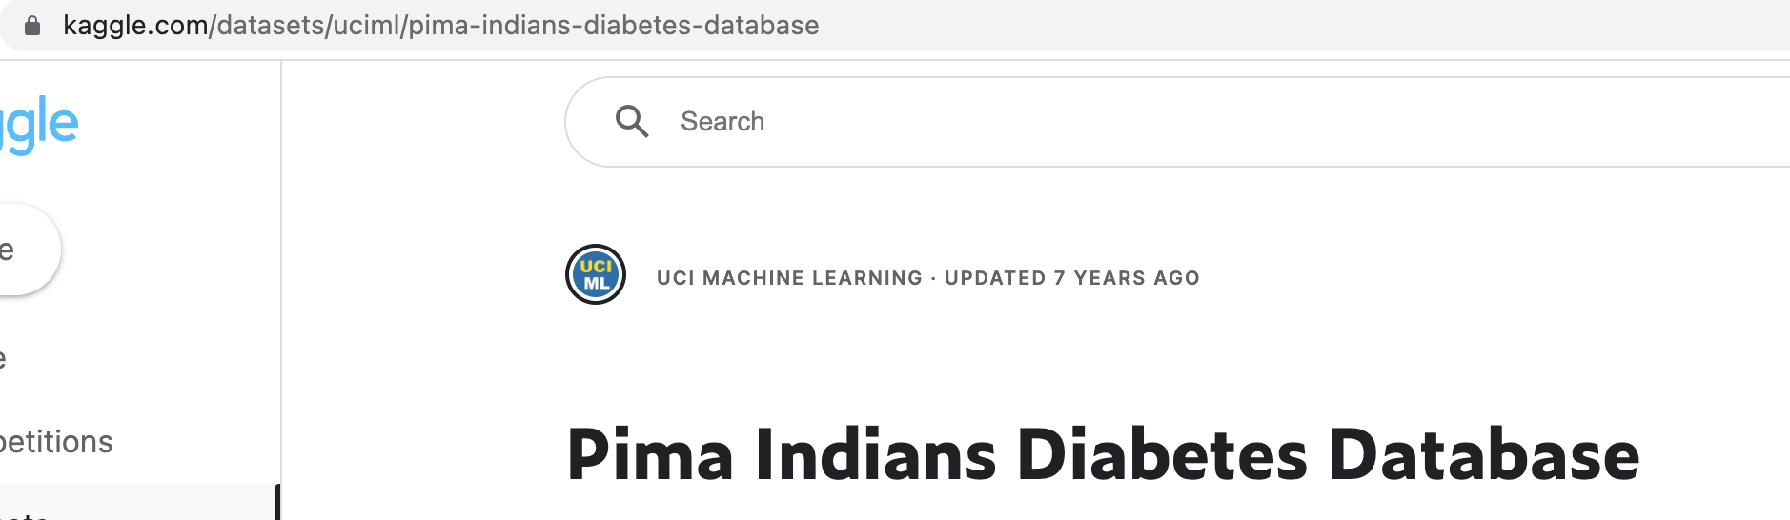
1. Gathering the Data
We use the Pima Indian dataset, made available by the National Institute of Diabetes at the Johns Hopkins University.

Slide 12

About the dataset
The Pima are American Indians that live along the Gila River and Salt River in Southern Arizona.

Slide 13
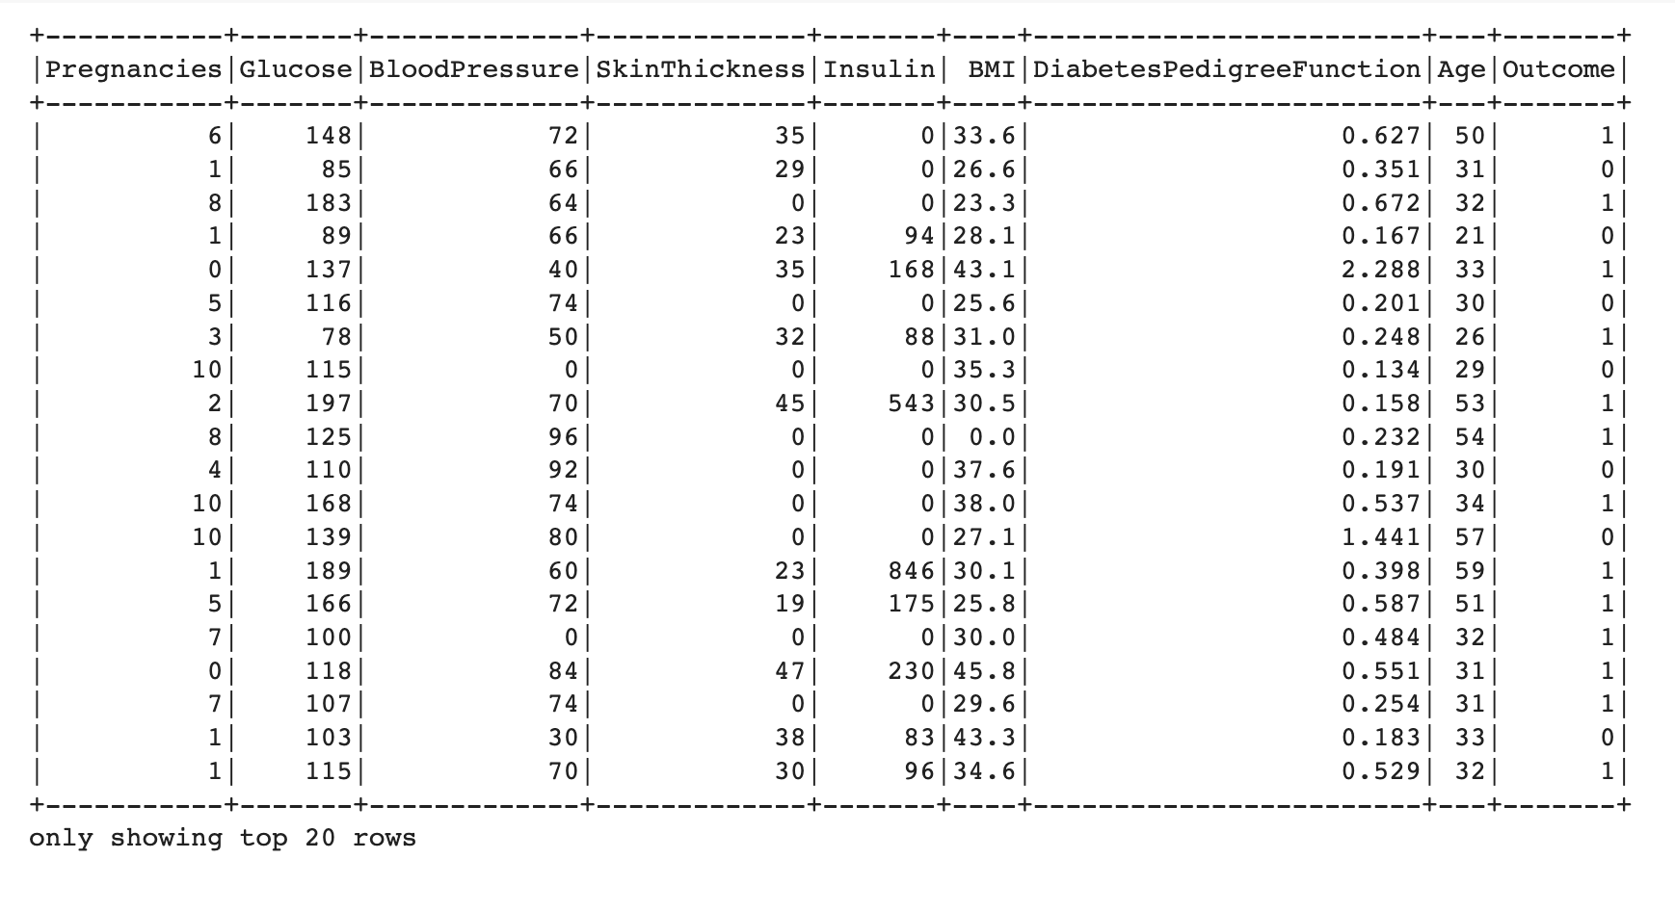
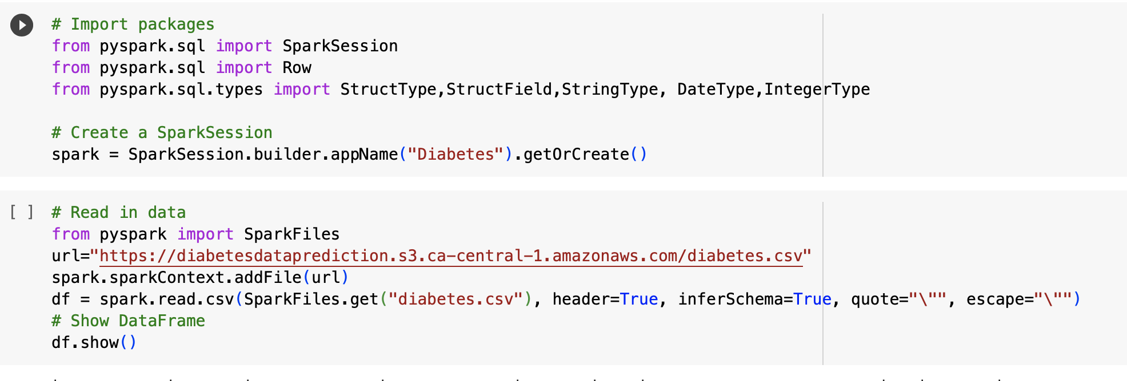
Diabetes Data imported using Spark

Slide 14
Diabetes Data imported using Spark

Slide 15
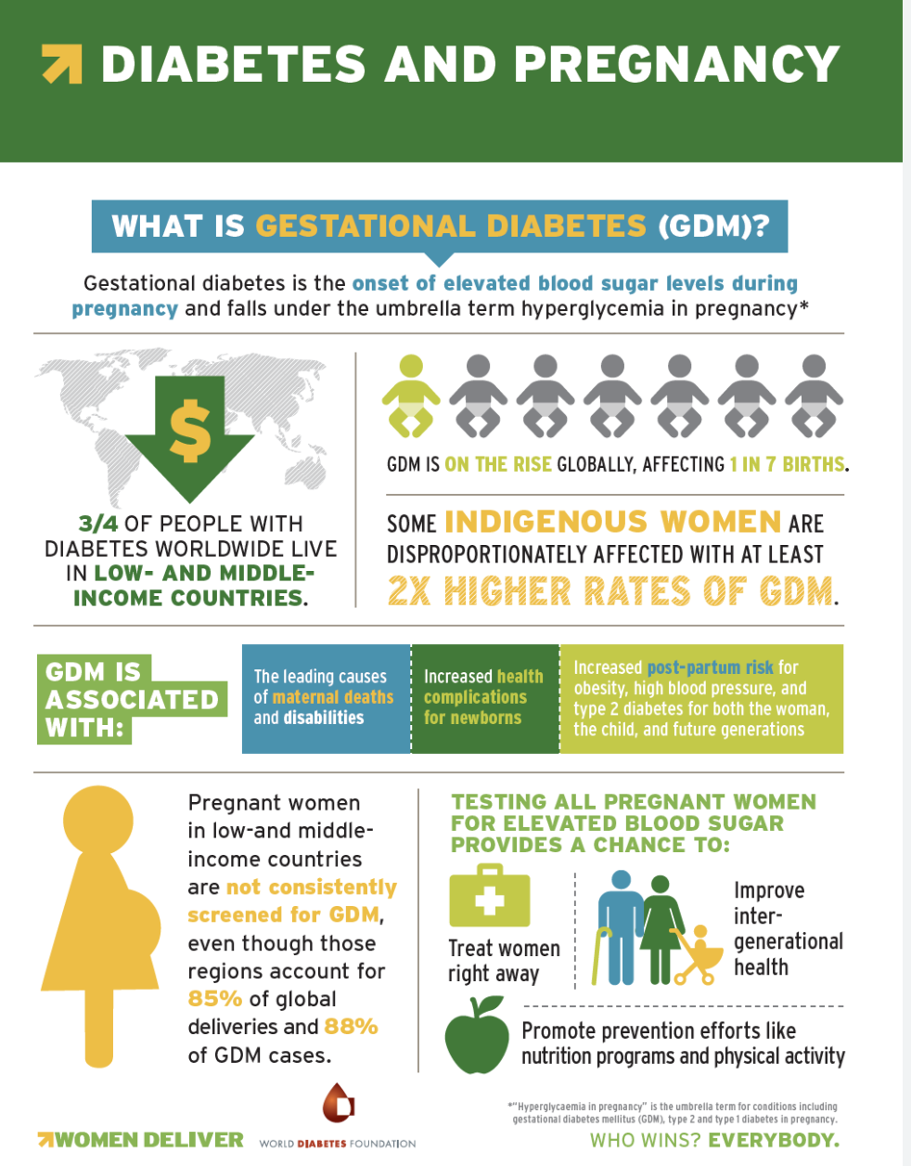
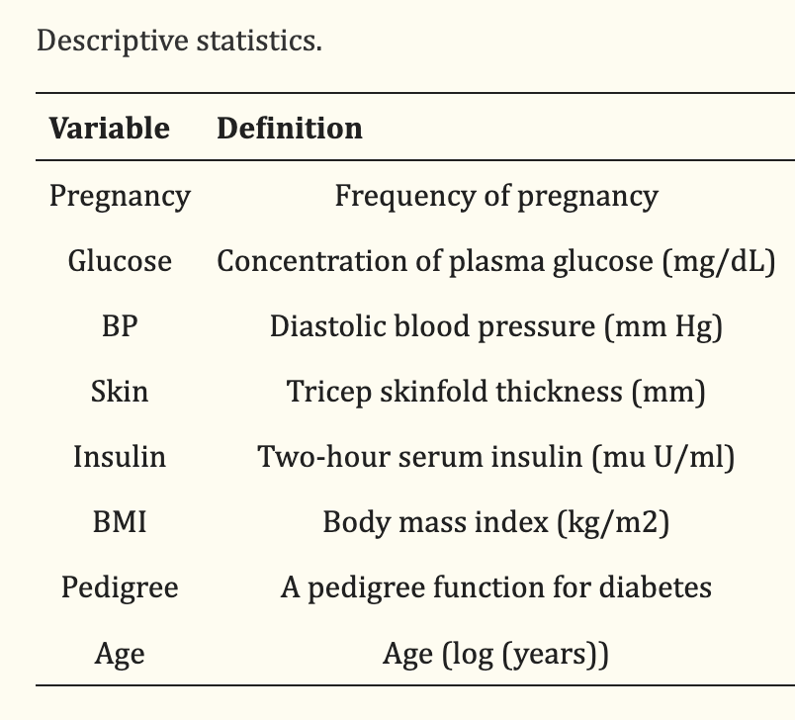
Diabetes Data

Slide 16
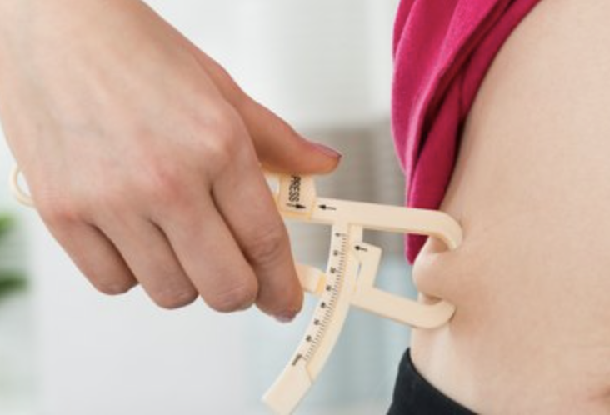
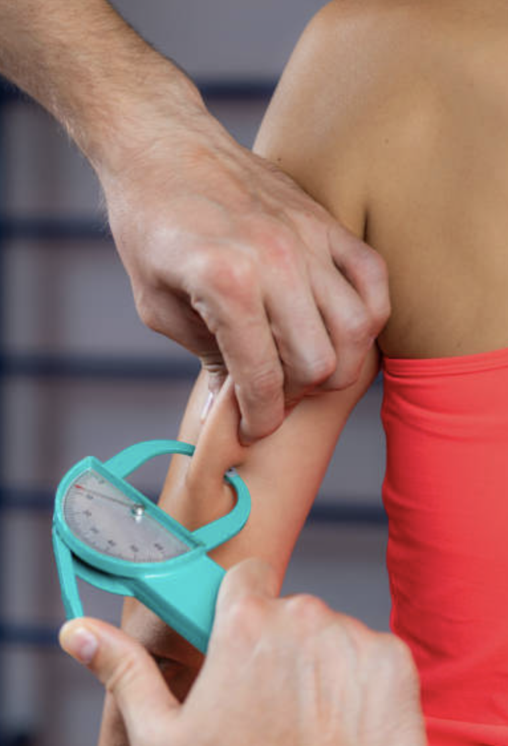
Diabetes Data imported using Spark

Slide 17
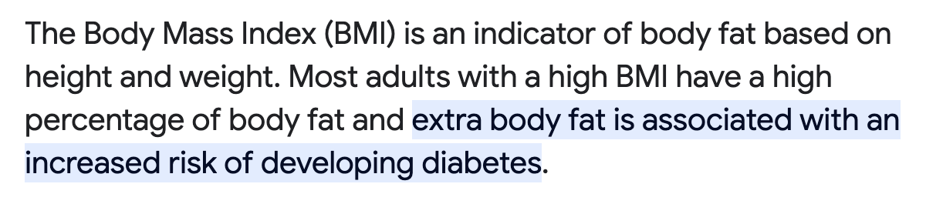
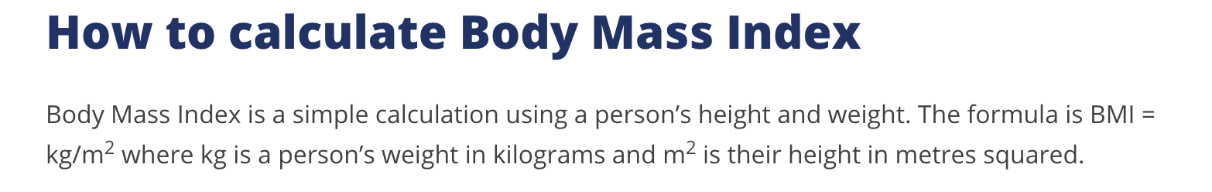
Diabetes Data imported using Spark

Slide 18
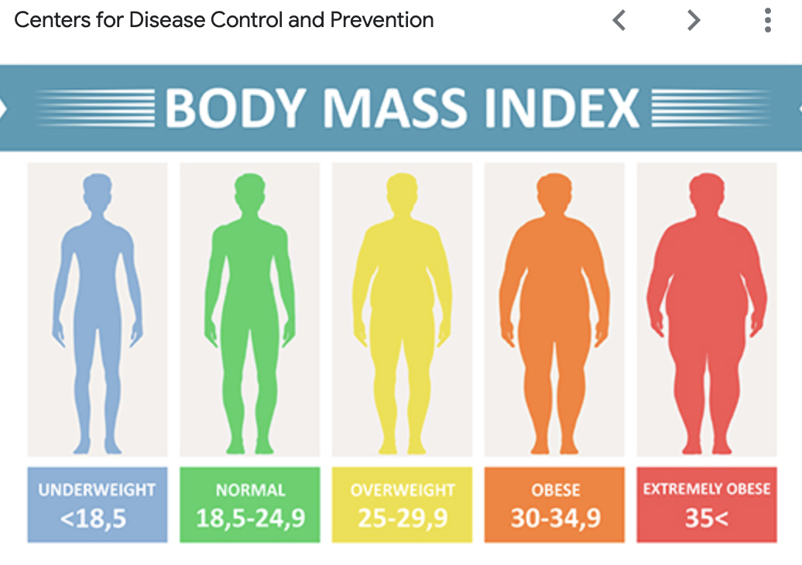

Slide 19
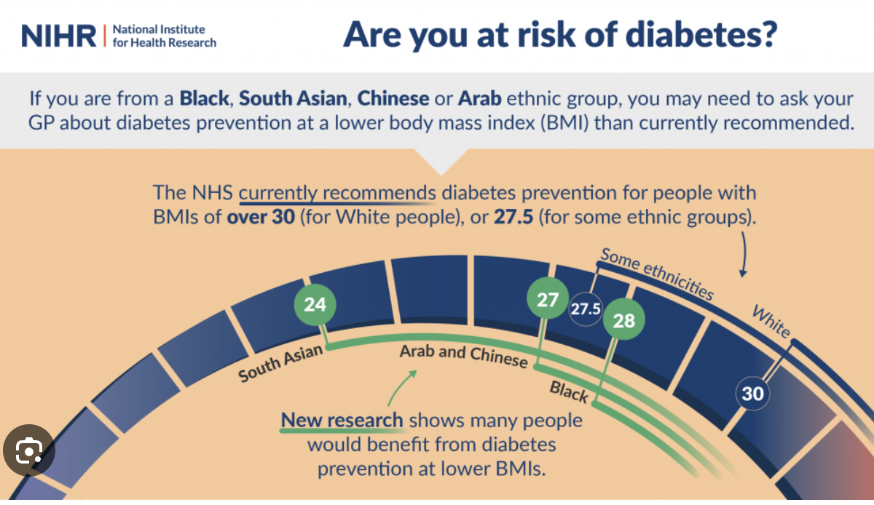

Slide 20
Diabetes Data

Slide 21
Diabetes Data imported using Spark
Pedigree provides a synthesis of the diabetes mellitus history in ancestors and the genetic relationship with the subject. It utilizes information from a person’s family history to predict how likely a subject can get diabetes

Slide 22
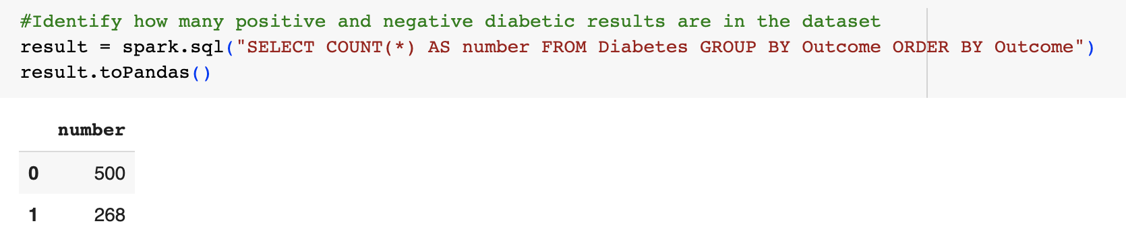
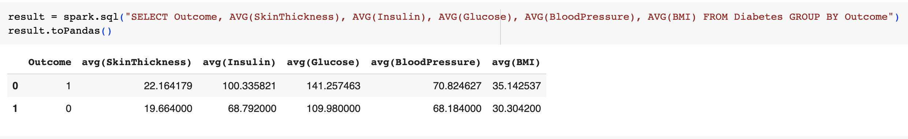
Data Pre-Processing
2. Diabetes Data Pre-Processing

Slide 23
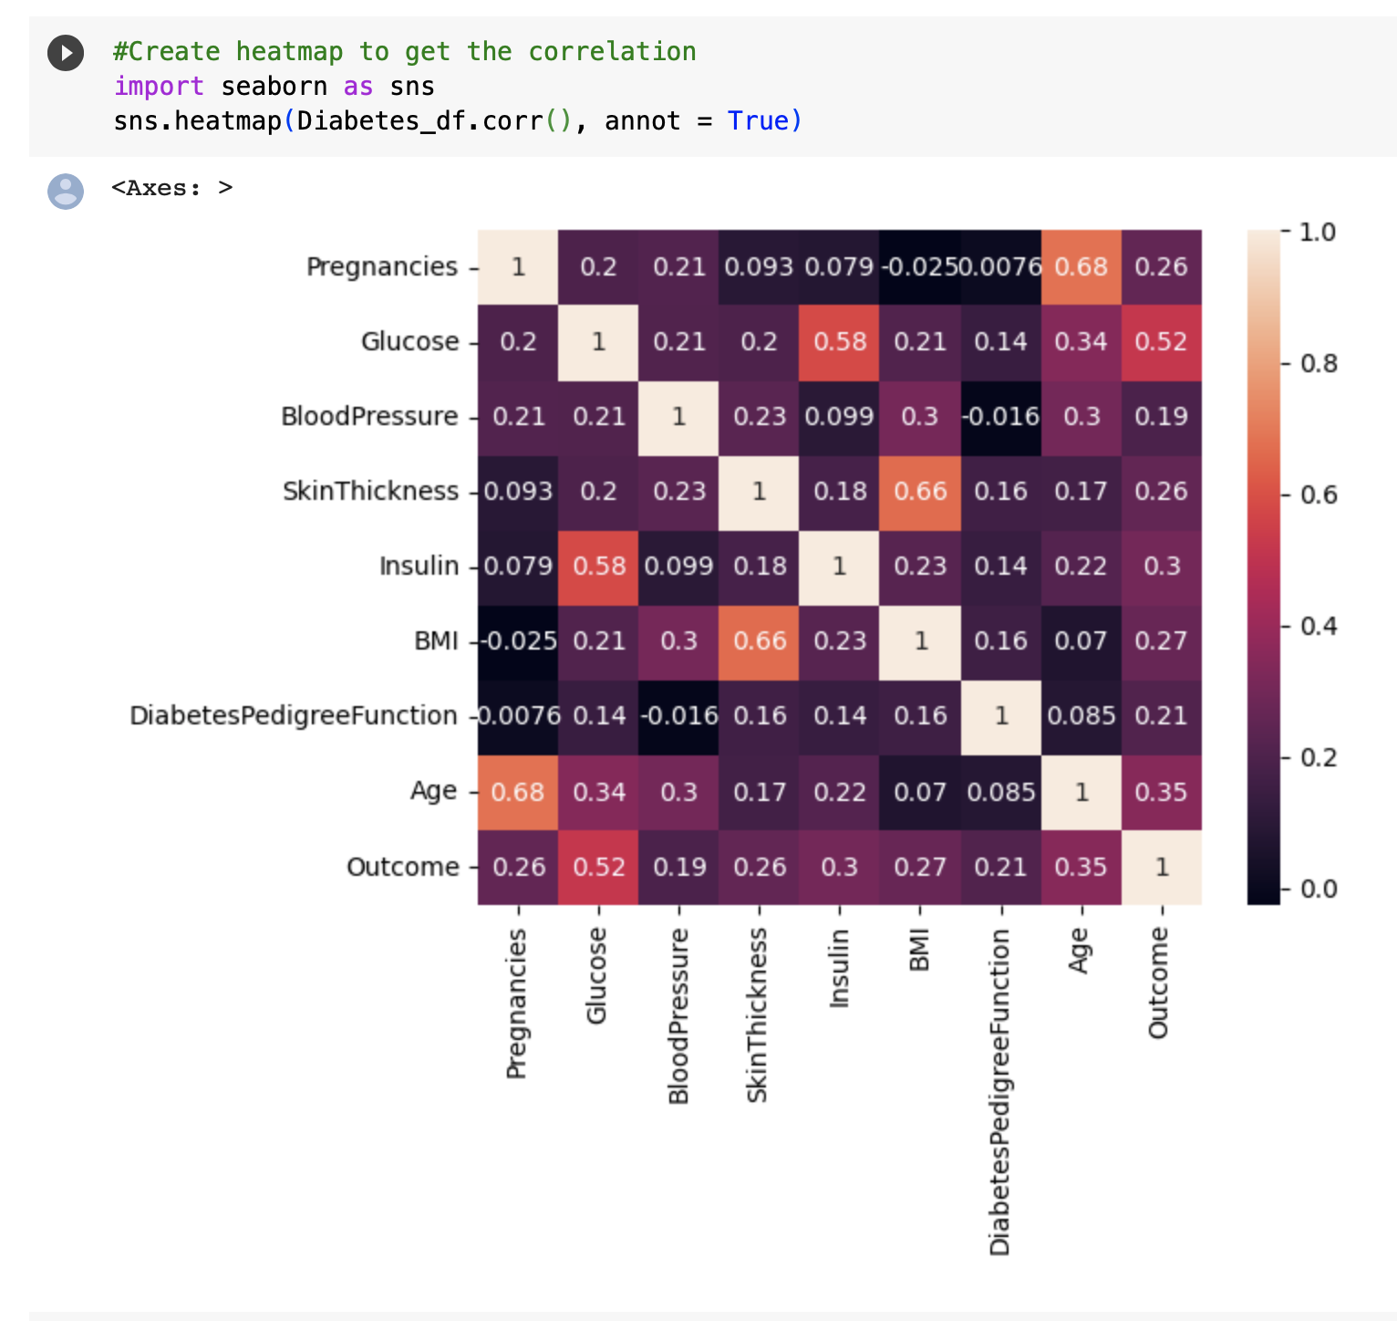
Visualizations
Diabetes Data
Correlation Matrix
(Heat Map)

Slide 24
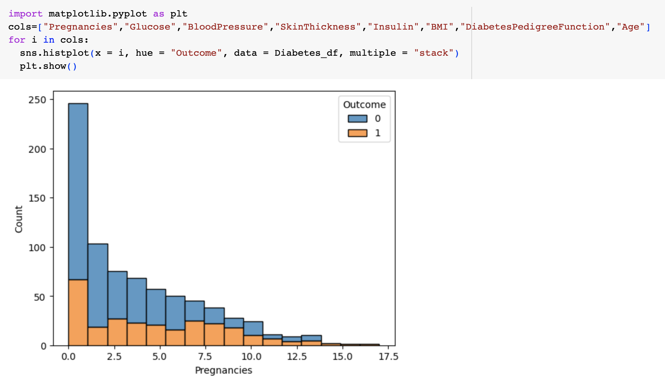

Slide 25
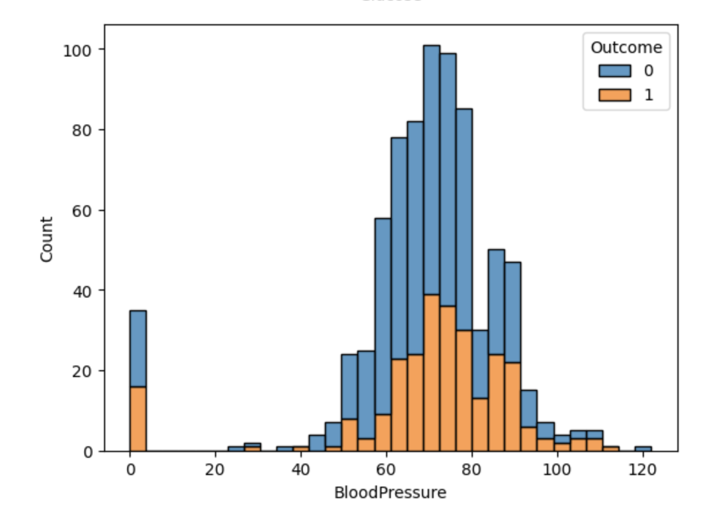
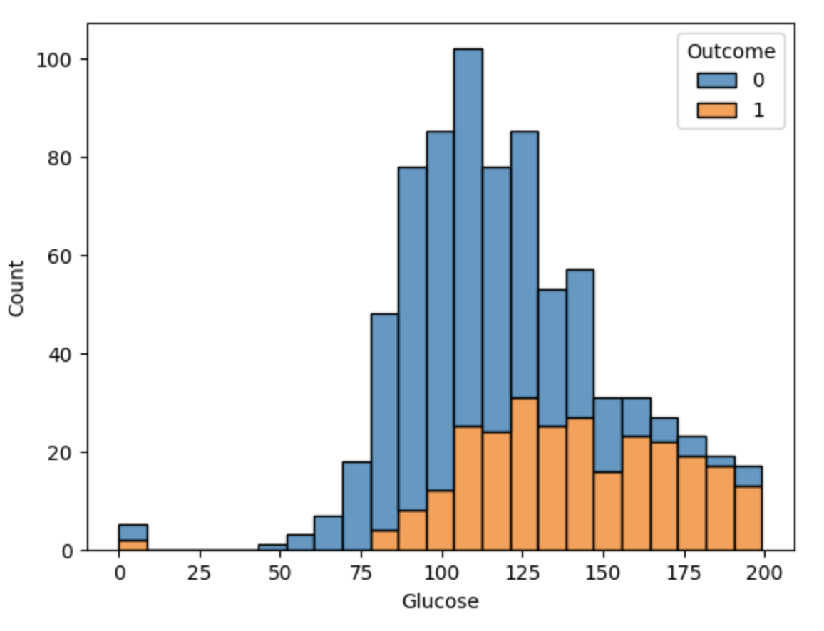
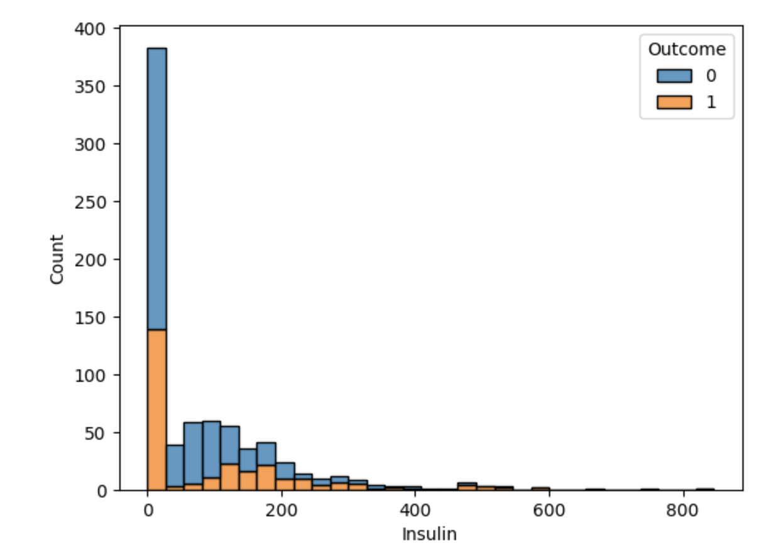
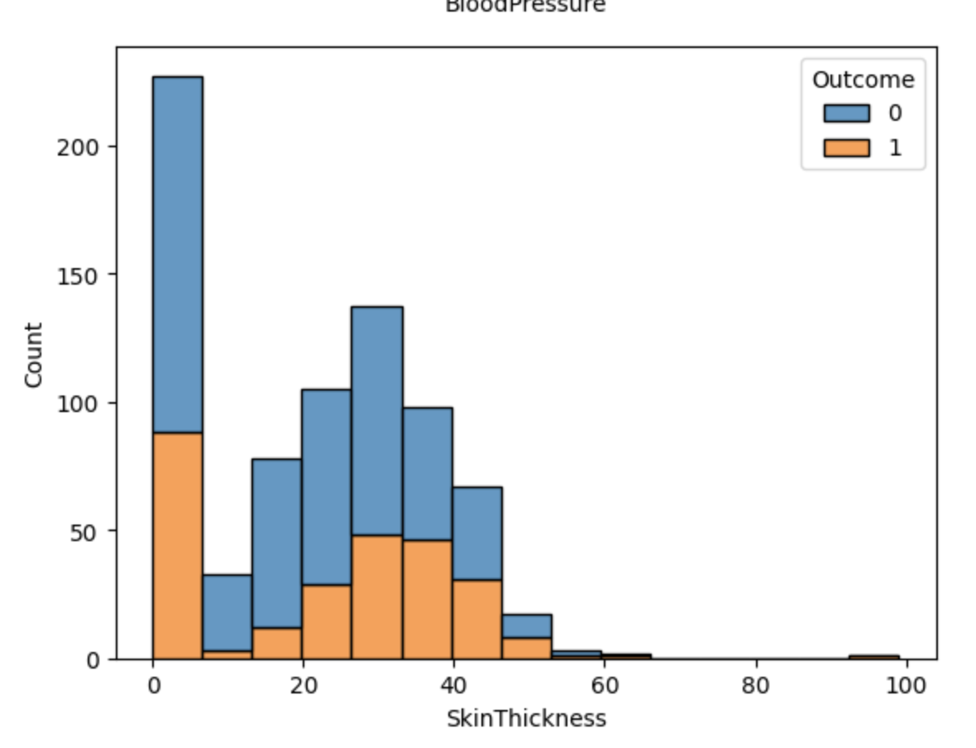

Slide 26
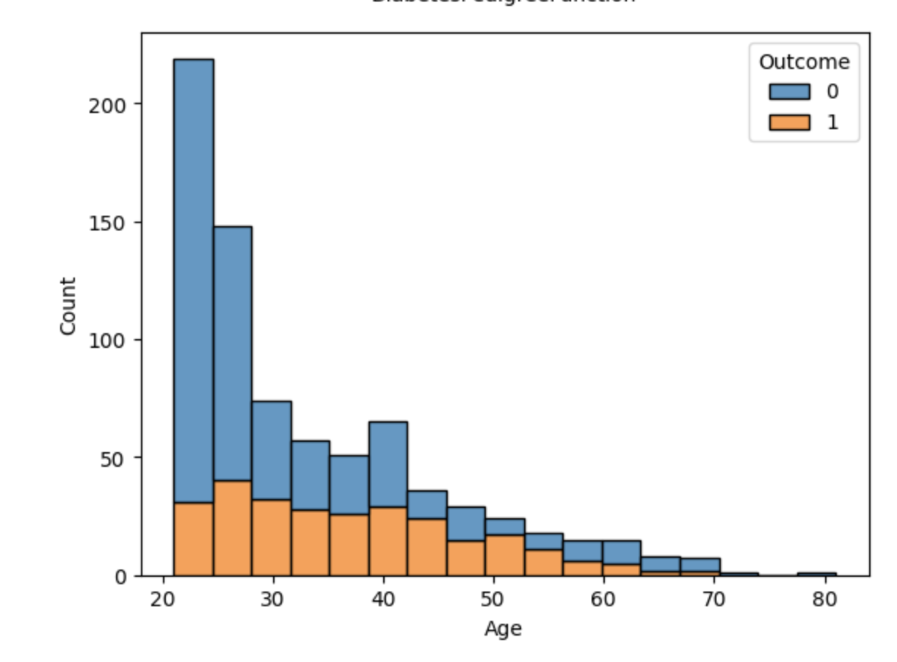
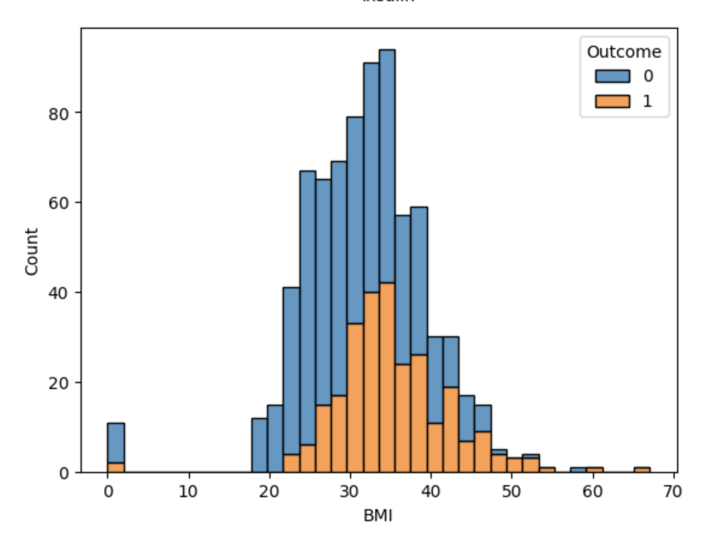
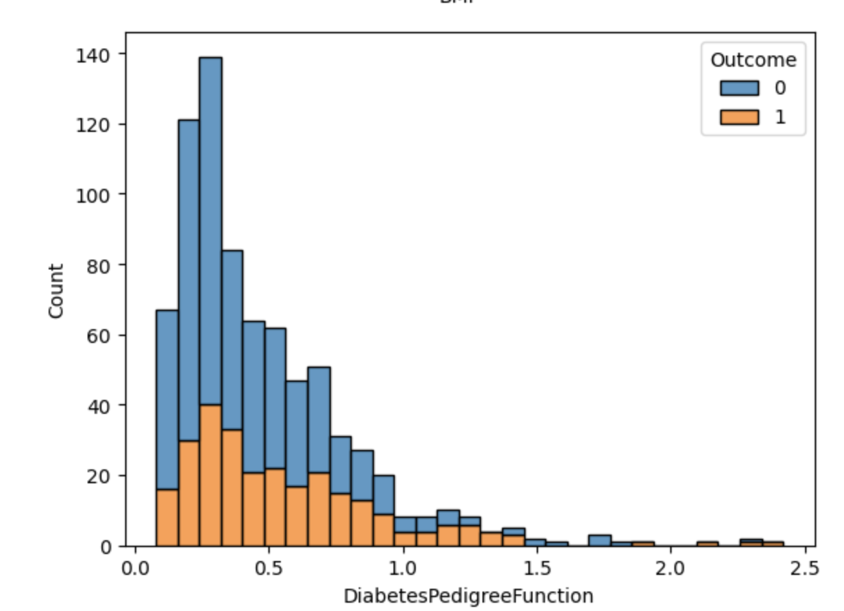

Slide 27
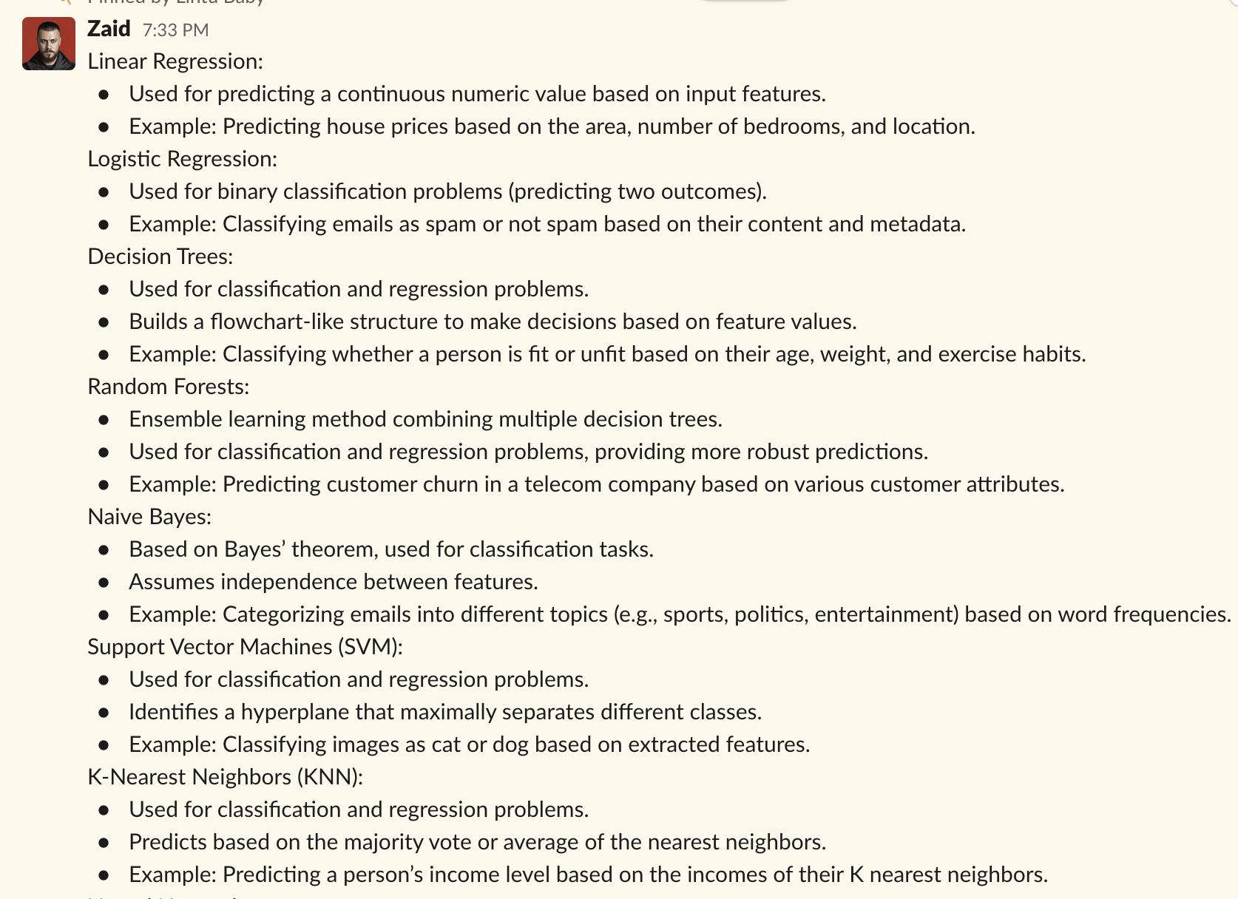
Researching the models

Slide 28
3. Researching the most appropriate models
1. Logistic Regression
2. Random Forest Classifier
3. KNN
4. SVM

Slide 29
Training and testing the ML models
The most crucial part of working with a machine learning model for diabetes is training it. During training, the model learns and comprehends the available diabetes data. Once the model has learned from the data, we evaluate its performance by providing it with another dataset.
This evaluation helps us assess how well the model is performing. If the model performs well during evaluation, we proceed to test it using test data.
Testing allows us to determine the final performance of the model, which can be measured using metrics like Accuracy, Recall, Precision, and by generating a classification report.

Slide 30
Building our Diabetes prediction model
The process of building and deploying a model involves 3 distinct datasets: Training data, Validation data, and Testing data. These datasets are created by splitting the available data using the train_test_split( ) function.
1. Training data: This dataset is used to train the model. It contains labeled examples of input data (features) and their corresponding desired outputs (labels). The model learns from this data to make predictions.
2. Validation: Once the model is trained, it needs to be evaluated to assess its performance and fine-tune its parameters. The validation dataset, which is separate from the training data, is used for this purpose. It helps us determine how well the model is generalizing and allows us to make adjustments if necessary.
3. Testing data: After the model has been trained and validated, it is ready for testing. Testing the dataset is to assess the final performance of the model. It represents unseen data that the model hasn't encountered before. By evaluating the model's predictions on this dataset, we can measure its effectiveness and determine how well it will perform in real-world scenarios.
By splitting the available data into training, validation, and testing datasets, we can effectively build and deploy a model, ensuring that it is trained, evaluated, and tested on different sets of data.

Slide 31
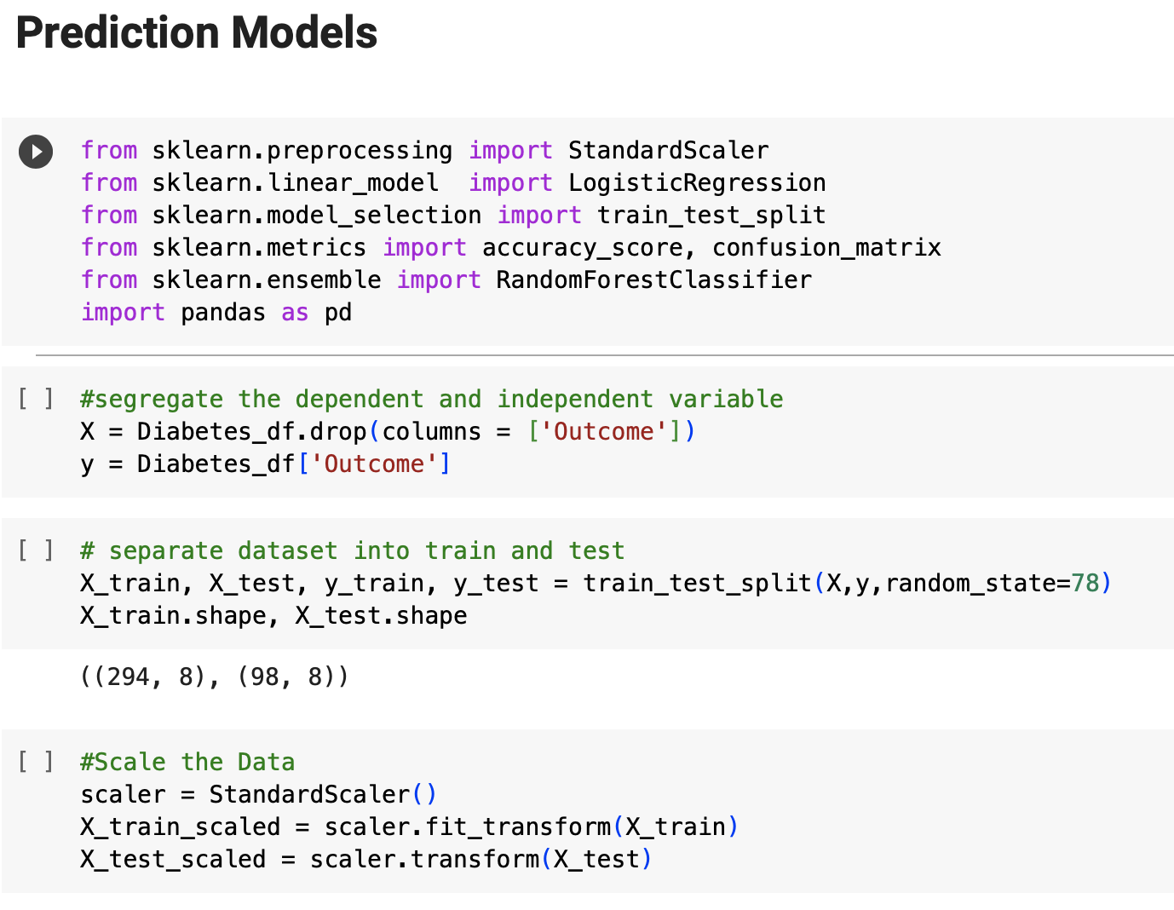
Training and testing the models

Slide 32
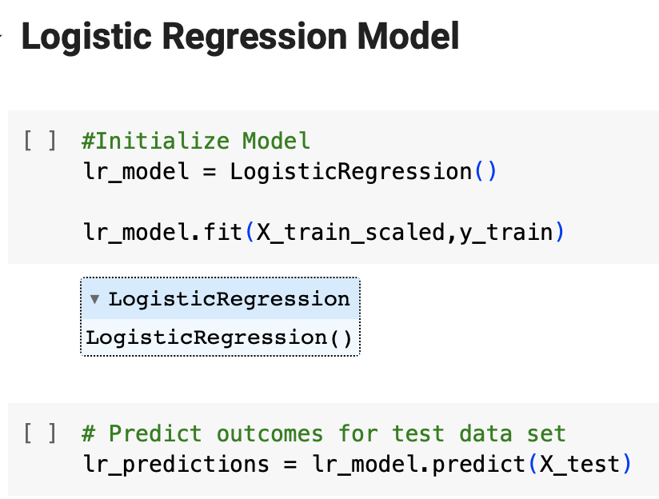

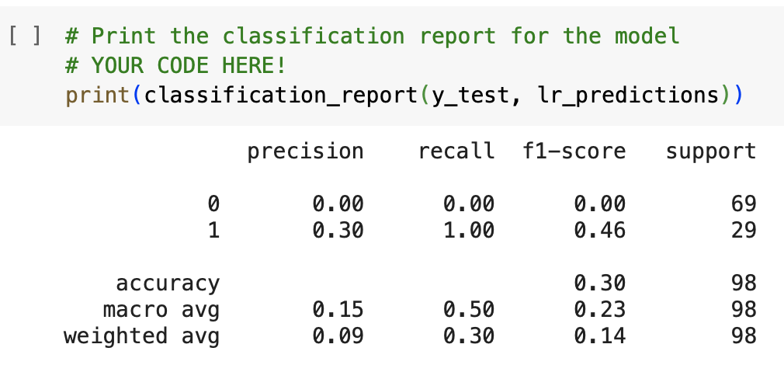

Slide 33
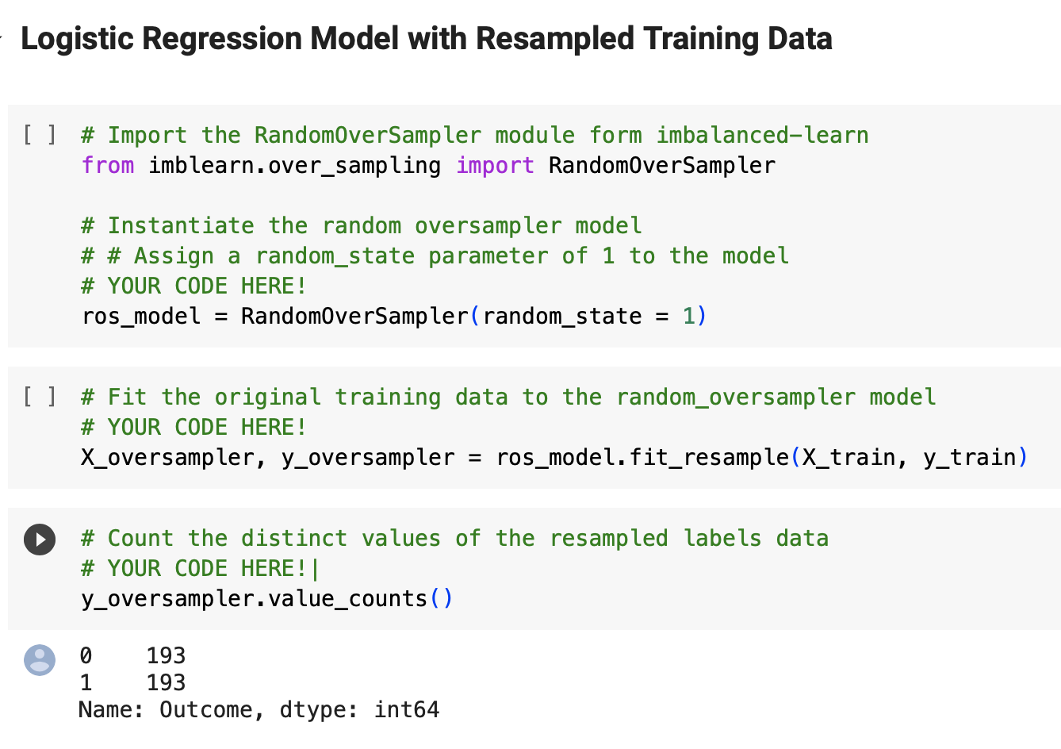
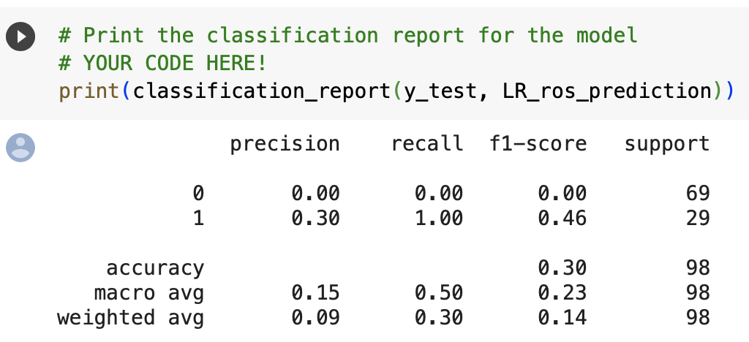
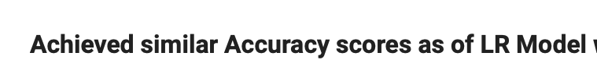

Slide 34
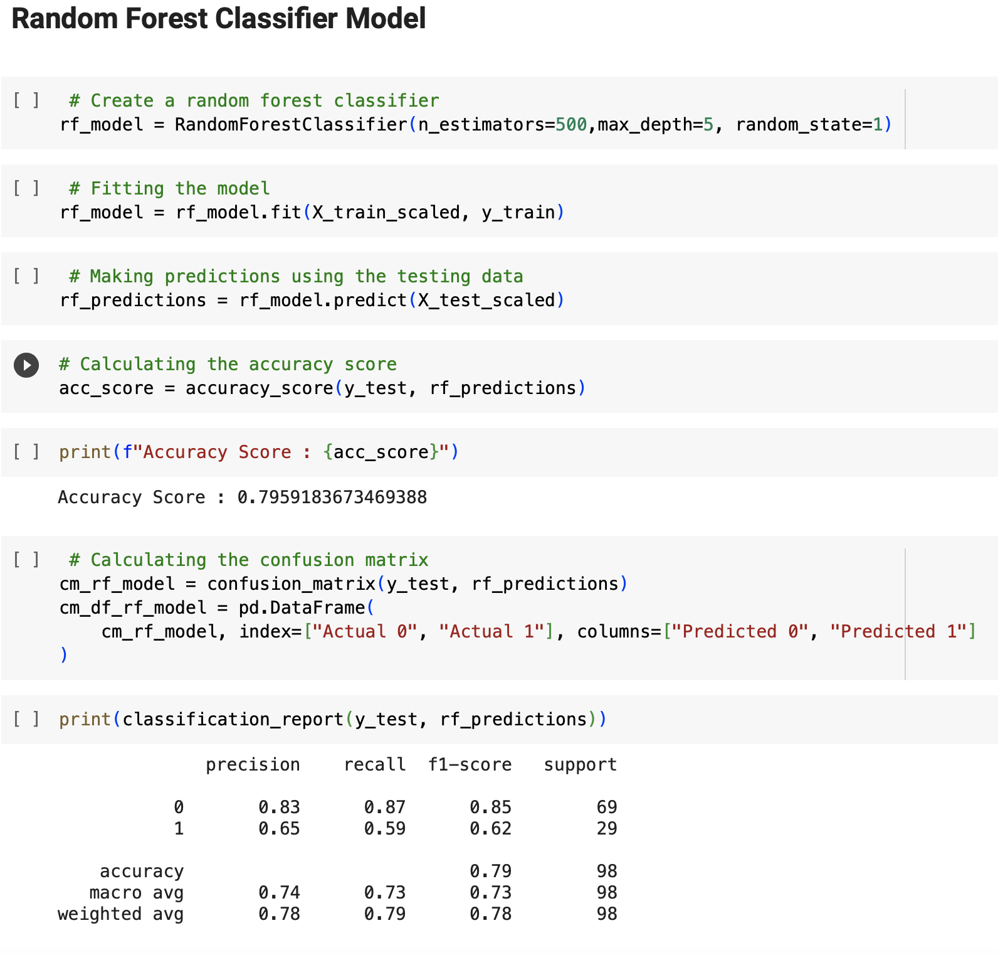
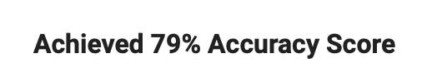

Slide 35
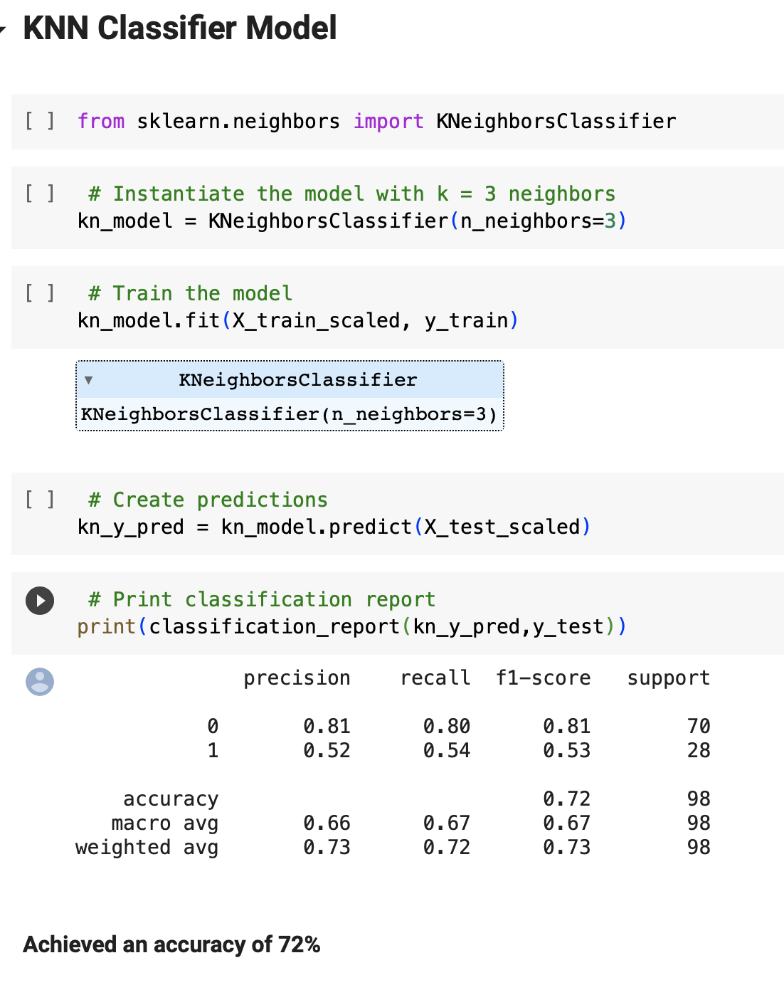

Slide 36

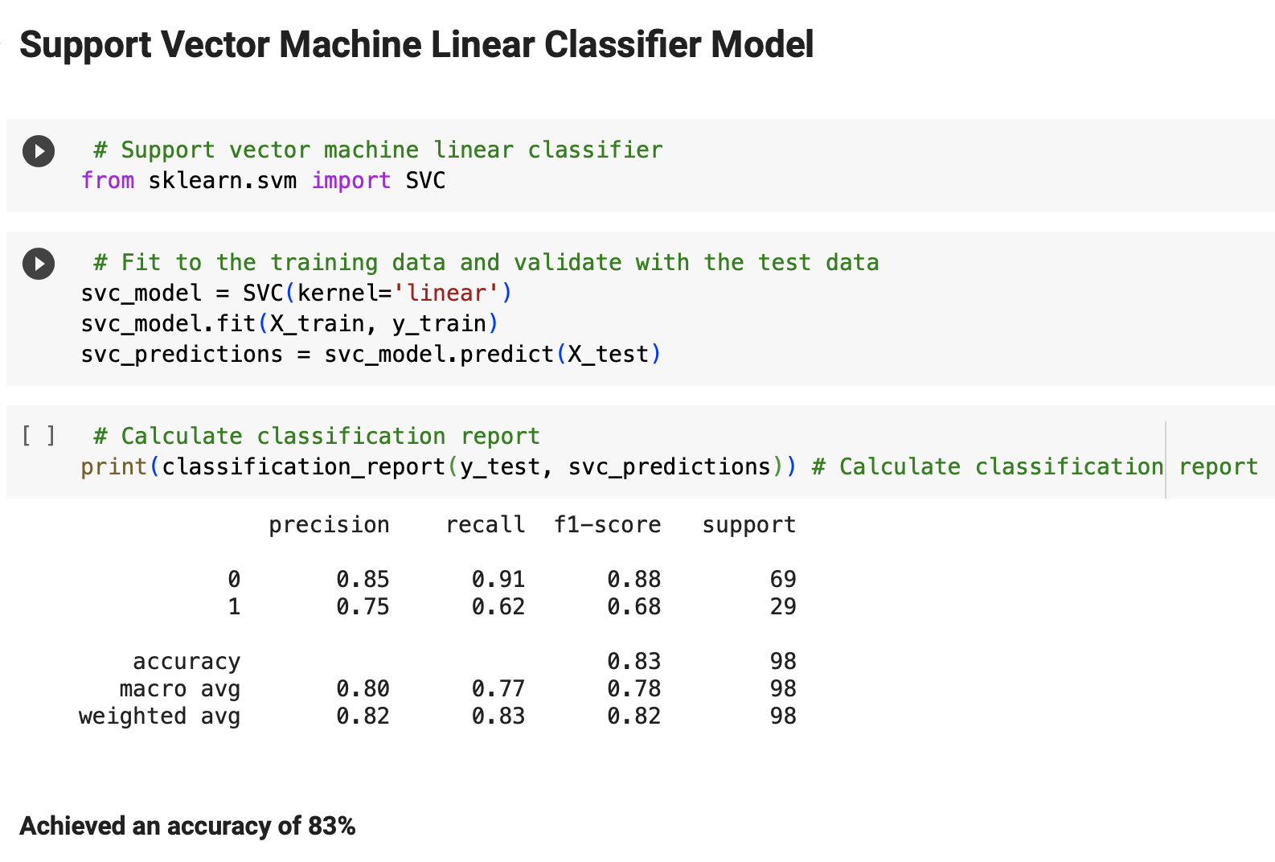
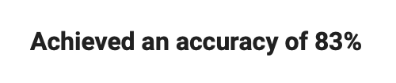

Slide 37

Limitations
Limited variables used to predict diabetes risk may limit the applicability of our results due to data constraints. Larger datasets with more variables may yield different outcomes.
We excluded the missing values in the data, which despite of being a usual practice, it could modify the results.

Slide 38
Conclusion
Identifying subjects at high risk of developing diabetes is a critical component of disease prevention.
We identified the critical variables in predicting type 2 DM, which are BMI, age, skin thickness and multiple pregnancies in women.
We built the model using some machine learning algorithms such as Logistic Regression, Random Forests, K-Nearest Neighbor (KNN) and Support Vector Machine (SVM) and we conclude that our proposed model has a prediction accuracy of 83%
The best accuracy was achieved with SVM.

Slide 39


https://www.healthycanadians.gc.ca/en/canrisk

Slide 40




